Slide 1
Analog Transmission: ASK, FSK, PSK & QPSK
Course Code: COE 3201
Course Title: Data Communication
Dept. of Computer Engineering
Faculty of Engineering
Lecture No: | 7 | Week No: | 8 | Semester:
Lecturer:

Slide 2
Lecture Outline
Digital to Analog Conversion
Aspects of Conversion
Amplitude Shift Keying
Frequency Shift Keying
Phase Shift Keying
Constellation Diagram

Slide 3
Digital to Analog Conversion
Digital-to-analog conversion is the process of changing one of the characteristics of an analog signal based on the information in digital data.
Figure 5.1 shows the relationship between the digital information, the digital-to-analog modulating process, and the resultant analog signal

Slide 4
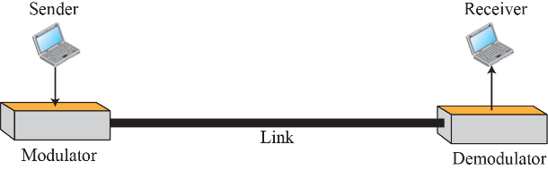
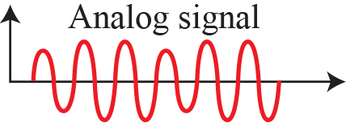
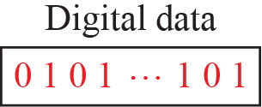
Digital to Analog Conversion
Figure 5.1: Digital-to-analog conversion

Slide 5
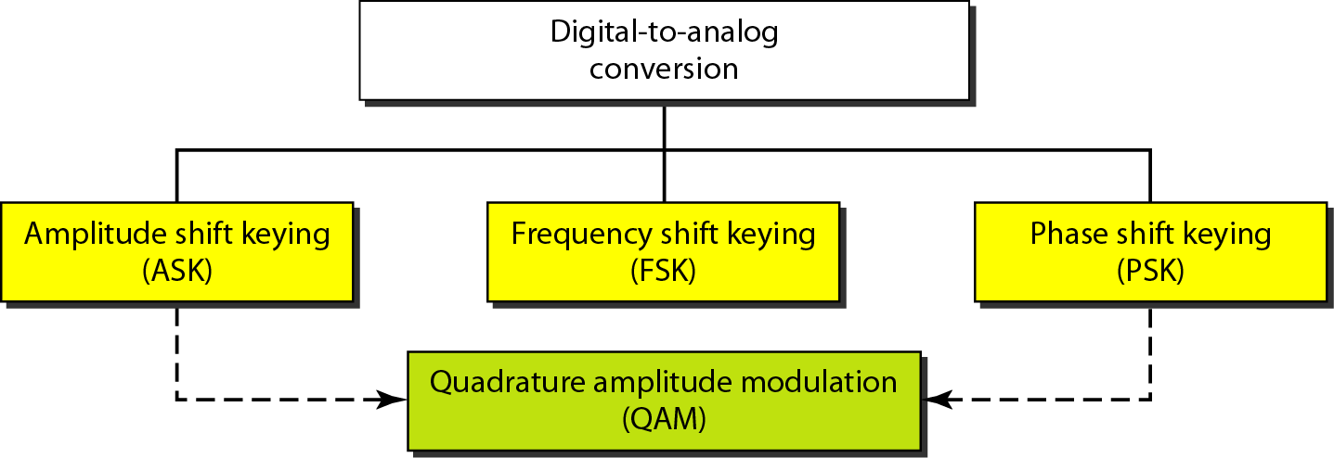
Digital to Analog Conversion
Types of digital to analog conversion

Slide 6
Aspects of Conversion
Before we discuss specific methods of digital-to-analog modulation, two basic issues must be reviewed: bit and baud rates and the carrier signal.
Bit rate: is the number of bits sent in 1s, expressed in bits per second (bps).
Baud rate: is the number of signal elements sent in 1s.
Carrier signal: In analog transmission, sender produces a high-frequency signal that acts as a base for the information signal. This base signal is called carrier signal.

Slide 7
Aspects of Conversion
Example 5.1: An analog signal carries 4 bits per signal element. If 1000 signal elements are sent per second, find the bit rate.
Solution: In this case, r = 4, S = 1000, and N is unknown. We can find the value of N from

Slide 8
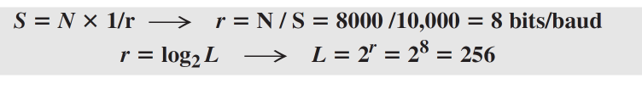
Aspects of Conversion
Example 5.2: An analog signal has a bit rate of 8000 bps and a baud rate of 1000 baud. How many data elements are carried by each signal element? How many signal elements do we need?
Solution: In this example, S = 1000, N = 8000, and r and L are unknown. We first find the value of r and then the value of L

Slide 9
Amplitude Shift Keying
In amplitude shift keying, the amplitude of the carrier signal is varied to create signal elements. Both frequency and phase remain constant while the amplitude changes.

Slide 10
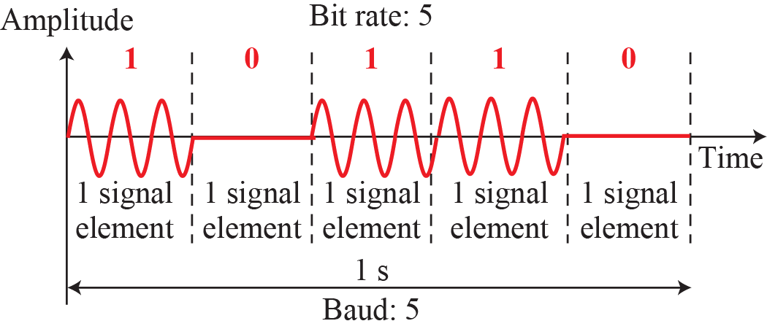
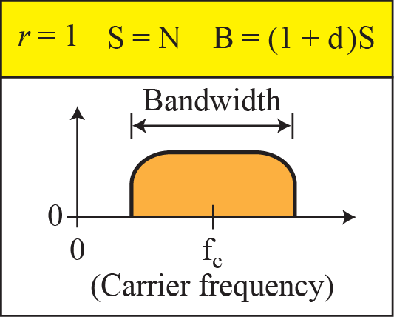
Binary Amplitude Shift Keying

Slide 11
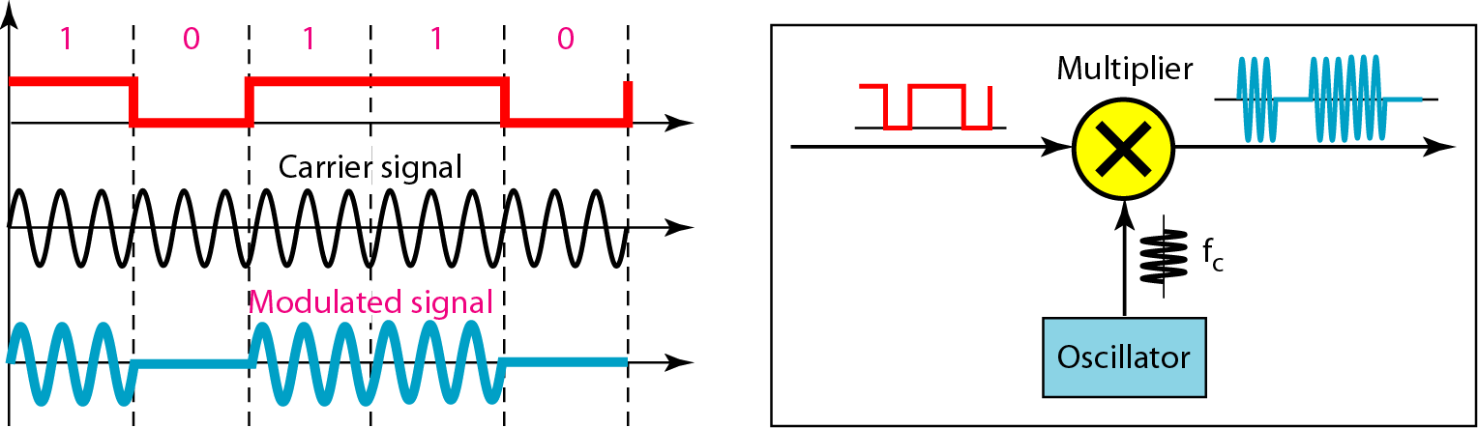
Implementation of binary ASK

Slide 12
Implementation of binary ASK

Slide 13
Amplitude Shift Keying
Example 5.3: We have an available bandwidth of 100 kHz which spans from 200 to 300 kHz. What are the carrier frequency and the bit rate if we modulated our data by using ASK with d = 1?
Solution: The middle of the bandwidth is located at 250 kHz. This means that our carrier frequency can be at fc = 250 kHz. We can use the formula for bandwidth to find the bit rate (with d = 1 and r = 1).

Slide 14
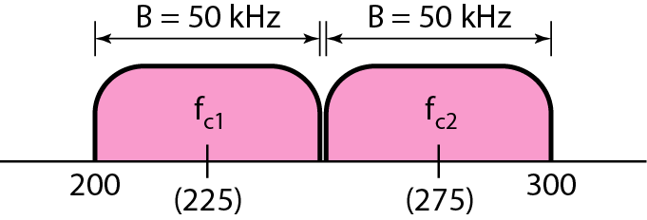
Amplitude Shift Keying
Example 5.4: In data communications, we normally use full-duplex links with communication in both directions. We need to divide the bandwidth into two with two carrier frequencies, as shown in Figure 5.5. The figure shows the positions of two carrier frequencies and the bandwidths. The available bandwidth for each direction is now 50 kHz, which leaves us with a data rate of 25 kbps in each direction.
Figure 5.5: Bandwidth of a full-duplex ASK

Slide 15
Frequency Shift Keying
In frequency shift keying, the frequency of the carrier signal is varied to represent data. The frequency of the modulated signal is constant for the duration of one signal element, but changes for the next signal element if the data element changes. Both peak amplitude and phase remain constant for all signal elements.

Slide 16
Frequency Shift Keying
In frequency shift keying, the frequency of the carrier signal is varied to represent data. The frequency of the modulated signal is constant for the duration of one signal element, but changes for the next signal element if the data element changes. Both peak amplitude and phase remain constant for all signal elements.

Slide 17
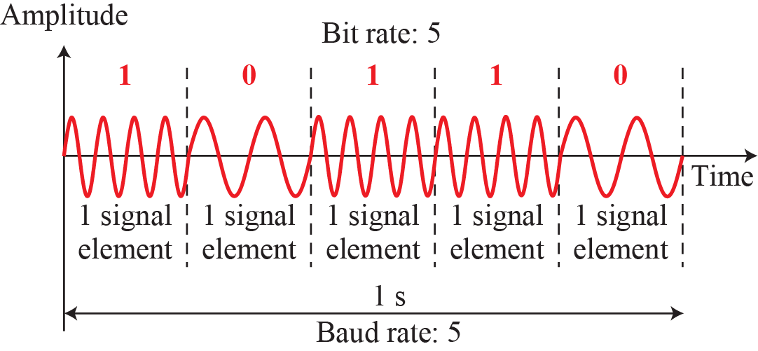
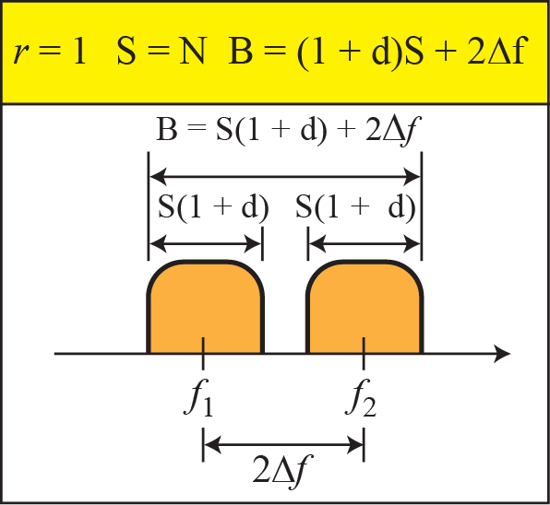
Binary Frequency Shift Keying

Slide 18
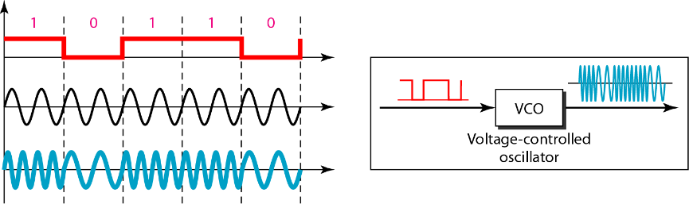
Implementation of BFSK

Slide 19
Frequency Shift Keying
Example 5.5: We have an available bandwidth of 100 kHz which spans from 200 to 300 kHz. What should be the carrier frequency and the bit rate if we modulated our data by using FSK with d = 1?
Solution: This problem is similar to Example 5.3, but we are modulating by using FSK. The midpoint of the band is at 250 kHz. We choose 2Δf to be 50 kHz; this means

Slide 20
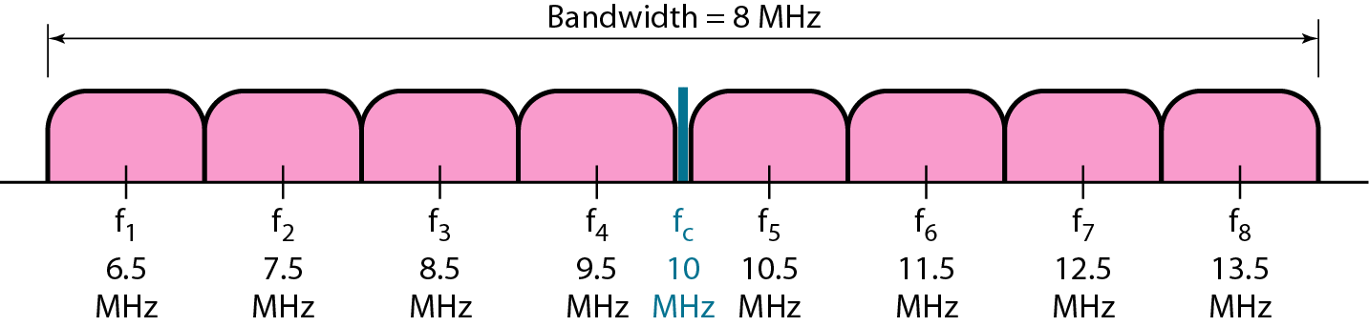
Frequency Shift Keying
Example 5.6: We need to send data 3 bits at a time at a bit rate of 3 Mbps. The carrier frequency is 10 MHz. Calculate the number of levels (different frequencies), the baud rate, and the bandwidth.
Solution: We can have L = 2³ = 8. The baud rate is S = 3 MHz/3 = 1 Mbaud. This means that the carrier frequencies must be 1 MHz apart (2Δf = 1 MHz). The bandwidth is B = 8 × 1 = 8 MHz.

Slide 21
Phase Shift Keying
In phase shift keying, the phase of the carrier is varied to represent two or more different signal elements. Both peak amplitude and frequency remain constant as the phase changes.
Today, PSK is more common than ASK or FSK.
However, we will see shortly that QAM, which combines ASK and PSK, is the dominant method of digital-to-analog modulation.

Slide 22
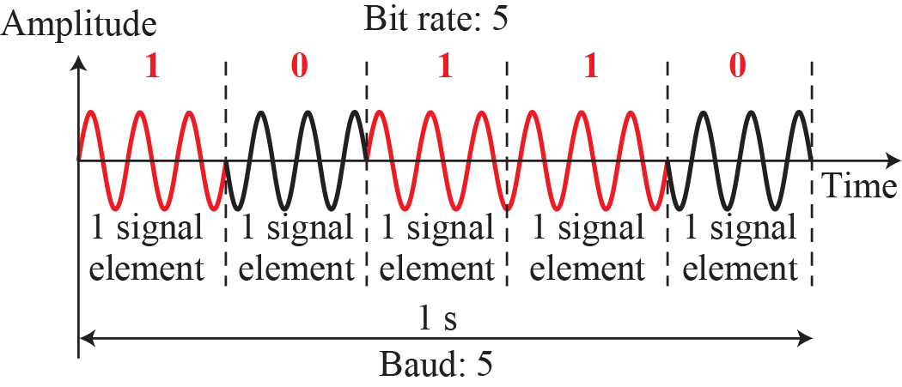
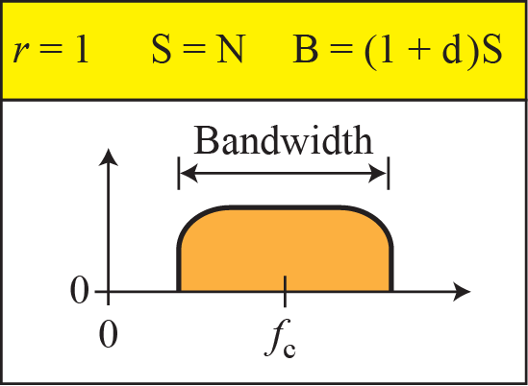
Binary Phase Shift Keying
The simplest PSK is binary PSK, in which we have only two signal elements, one with a phase of 0°, and the other with a phase of 180°.

Slide 23
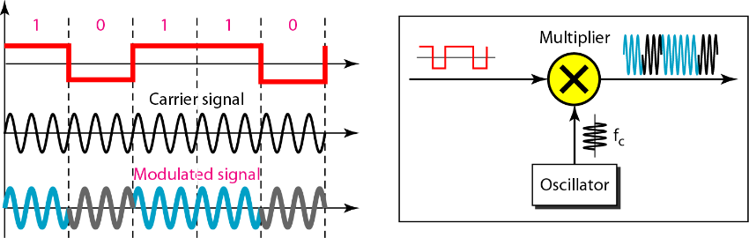
Implementation of BPSK

Slide 24
Quadrature PSK (QPSK)
The simplicity of BPSK enticed designers to use 2 bits at a time in each signal element, thereby decreasing the baud rate and eventually the required bandwidth.
The scheme is called quadrature PSK or QPSK because it uses two separate BPSK modulations; one is in-phase, the other quadrature (out-of-phase).
The incoming bits are first passed through a serial-to-parallel conversion that sends one bit to one modulator and the next bit to the other modulator.
If the duration of each bit in the incoming signal is T, the duration of each bit sent to the corresponding BPSK signal is 2T.

Slide 25
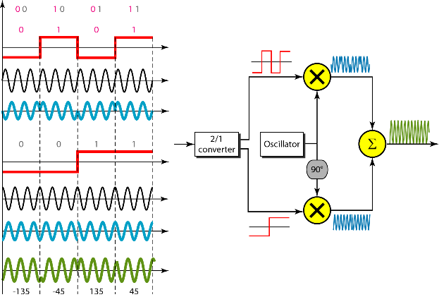
Implementation of QPSK

Slide 26
Quadrature PSK (QPSK)
Example 5.7: Find the bandwidth for a signal transmitting at 12 Mbps for QPSK. The value of d = 0.
Solution: For QPSK, 2 bits are carried by one signal element. This means that r = 2. So the signal rate (baud rate) is S = N × (1/r) = 6 Mbaud. With a value of d = 0, we have B = S = 6 MHz.

Slide 27
Constellation Diagram
A constellation diagram can help us define the amplitude and phase of a signal element, particularly when we are using two carriers (one in-phase and one quadrature).
The diagram is useful when we are dealing with multilevel ASK, PSK, or QAM.
In a constellation diagram, a signal element type is represented as a dot.
The bit or combination of bits it can carry is often written next to it.

Slide 28
Constellation Diagram
The diagram has two axes. The horizontal X axis is related to the in-phase carrier; the vertical Y axis is related to the quadrature carrier.
For each point on the diagram, four pieces of information can be deduced. The projection of the point on the X axis defines the peak amplitude of the in-phase component; the projection of the point on the Y axis defines the peak amplitude of the quadrature component. The length of the line (vector) that connects the point to the origin is the peak amplitude of the signal element (combination of the X and Y components); the angle the line makes with the X axis is the phase of the signal element.

Slide 29
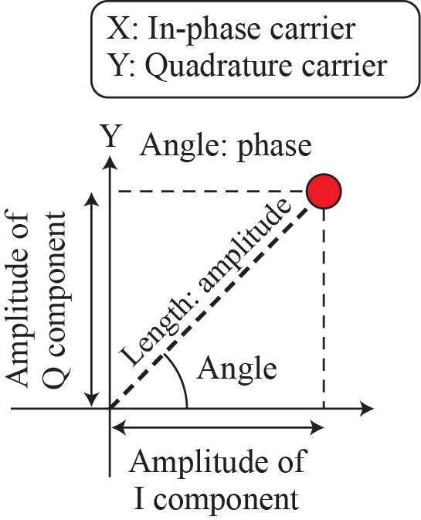
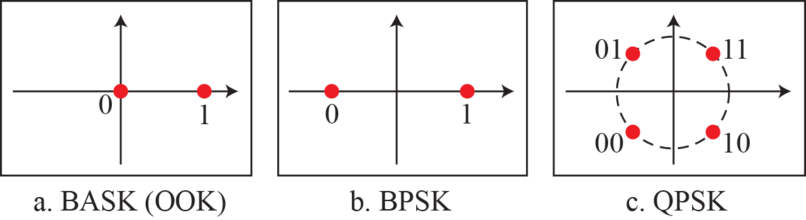
Constellation Diagram

Slide 30
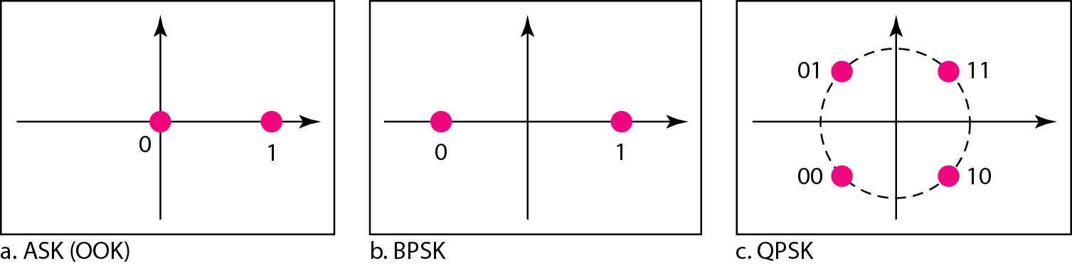
Constellation Diagram
Example 5.8: Show the constellation diagrams for ASK (OOK), BPSK, and QPSK signals.
Solution: Figure 5.13 shows the three constellation diagrams. Let us analyze each case separately:
Figure 5.13: Three constellation diagrams

Slide 31
Constellation Diagram ASK
For ASK, we are using only an in-phase carrier. Therefore, the two points should be on the X axis. Binary 0 has an amplitude of 0 V; binary 1 has an amplitude of 1 V (for example). The points are located at the origin and at 1 unit.
Figure 5.13: Three constellation diagrams

Slide 32
Constellation Diagram BPSK
BPSK also uses only an in-phase carrier. However, we use a polar NRZ signal for modulation. It creates two types of signal elements, one with amplitude 1 and the other with amplitude −1. This can be stated in other words: BPSK creates two different signal elements, one with amplitude 1 V and in phase and the other with amplitude 1 V and 180° out of phase.
Figure 5.13: Three constellation diagrams

Slide 33
Constellation Diagram QPSK
QPSK uses two carriers, one in-phase and the other quadrature. The point representing 11 is made of two combined signal elements, both with an amplitude of 1 V.
One element is represented by an in-phase carrier, the other element by a quadrature carrier.
The amplitude of the final signal element sent for this 2-bit data element is 2^{1/2}, and the phase is 45°.
The argument is similar for the other three points.

Slide 34
Constellation Diagram QPSK
All signal elements have an amplitude of 2^{1/2}, but their phases are different (45°, 135°, −135°, and −45°).
Of course, we could have chosen the amplitude of the carrier to be 1/(2^{1/2}) to make the final amplitudes 1 V.
Figure 5.13: Three constellation diagrams

Slide 35
Books
[1] Forouzan AB. Data communications & networking.
5th ed., Tata McGraw-Hill Education.

Slide 36
References
1. Prakash C. Gupta, “Data communications”, Prentice Hall India Pvt.
2. William Stallings, "Data and Computer Communications”, Pearson
3. Forouzan, B. A. "Data Communication and Networking. Tata McGraw." (2005).

